Slide 1


Slide 2

Smart
24/7
Pest Control

Slide 3
With Anticimex Smart, you’ll stay ahead of rodents and insects and
fight the problem with Data
Notes:
Imagine if I said to you I have the best security system in the world, I am going to come around every month and inspect your house. Just to see if you have been broken into. Obviously you would not be happy yet this is how we have conducted pest control for the last 100 years.
There is two main simple points to Smart Pest Control
To gauge the level pest of activity not relying on any pesticides as for example rodents may not always feed on toxic baits and we have no idea when. So we now have the technology to gauge the level activity and using smart with or without standard pest treatments to bring the pest level down to a controllable measure. Again not relying on bait which may not be consumed
To measure 24 / 7 and have no issues then all of sudden due to a environmental or behavioural issue pests activity starts to spike, we will know and proactively control this problem which may mean coming out earlier than the agreed standard service frequency.
How do we do all of that by “fighting the problem with real data”

Slide 4
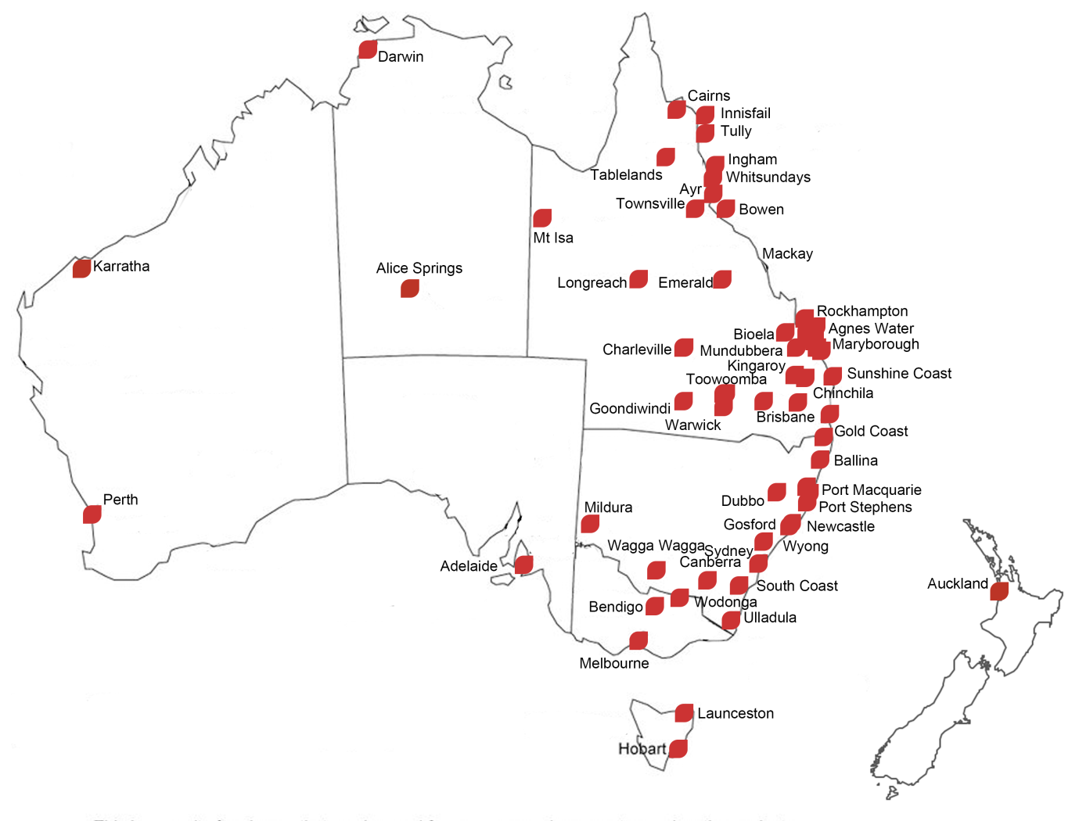
About Flick Anticimex
Flick Anticimex is the leading specialist in preventative pest control and related services, embracing new technology in giving our customers peace of mind in their daily lives. Flick is Australia’s original and most trusted Pest Control and Hygiene company with over 100 years of reliable, safe and professional service.
We proudly provide services to Australia’s major industrial, government, hospitality, health, aged care, resource and commercial sectors.
Our Services include:
Pest Control
Termite Control
Weed Control
Hygiene services
Hygiene Consumables

Slide 5
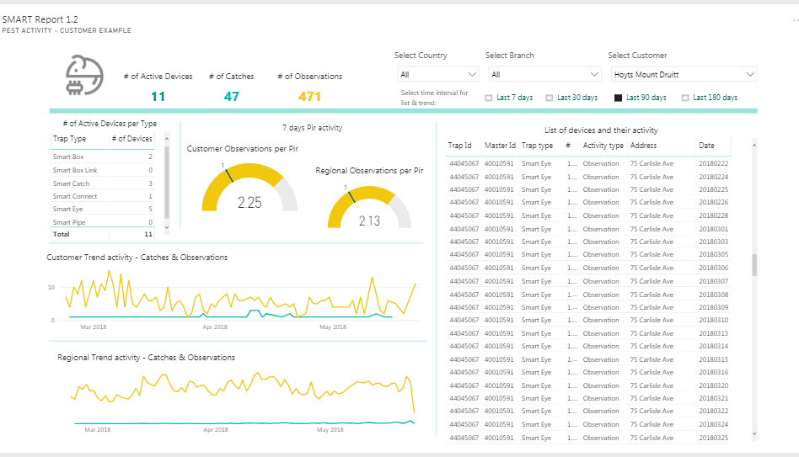
Power BI - Reporting

Slide 6
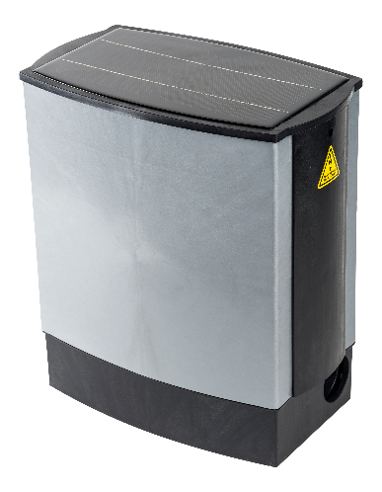
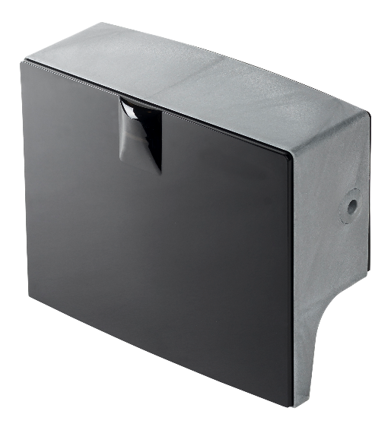
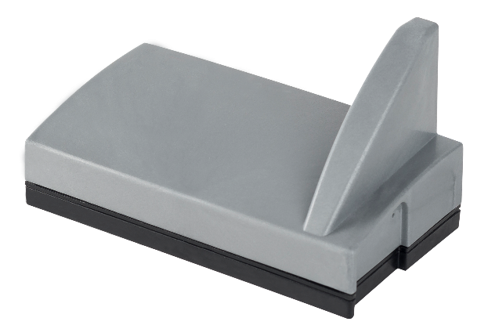
Smart Rodent Control
Smart Eye
Smart Eye is a small sensor that detects and reports movement. Thanks to its tiny size it’s often placed in narrow spaces typically favoured by rodents.
Smart Catch
Smart Catch is a single catch unit that detects and deals with rodents above ground.
Smart Box
Smart Box is a multi-catch unit that deals with rodents
above ground.

Slide 7
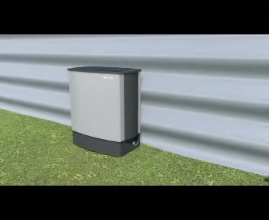
How it Works

Slide 8
History and Background for SMART Sense
Smart Rodent systems were the first to be designed
Insects are an important part of our service for customers in majority of Anticimex countries
Moth and Cockroach were the most important insects in our service portfolio
“The great advantage of SMART Sense is that we now can work with the SMART concept for practically all our clients, since we in many cases control rodents as well as insects.
Without this system, we had to work with the same client using two different approaches, one SMART and one traditional. Now we can provide a large percentage of our services with SMART, thanks to the SMART Sense”
Jordi Tapias, Technical Director Anticimex Spain

Slide 9
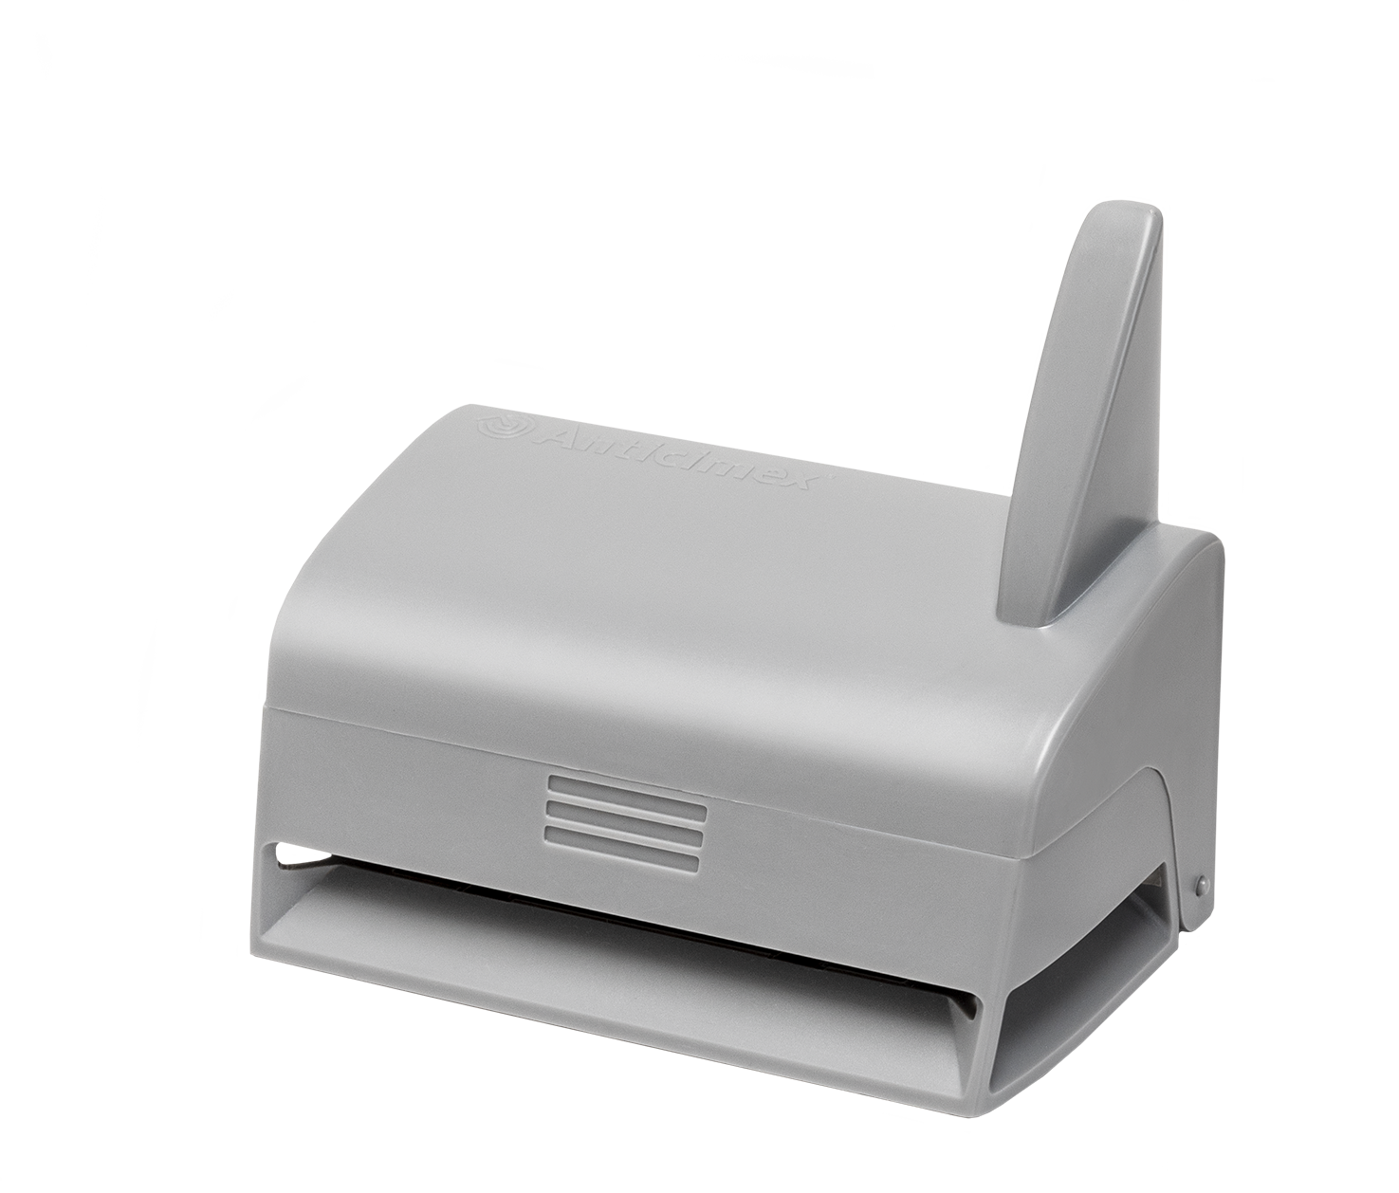
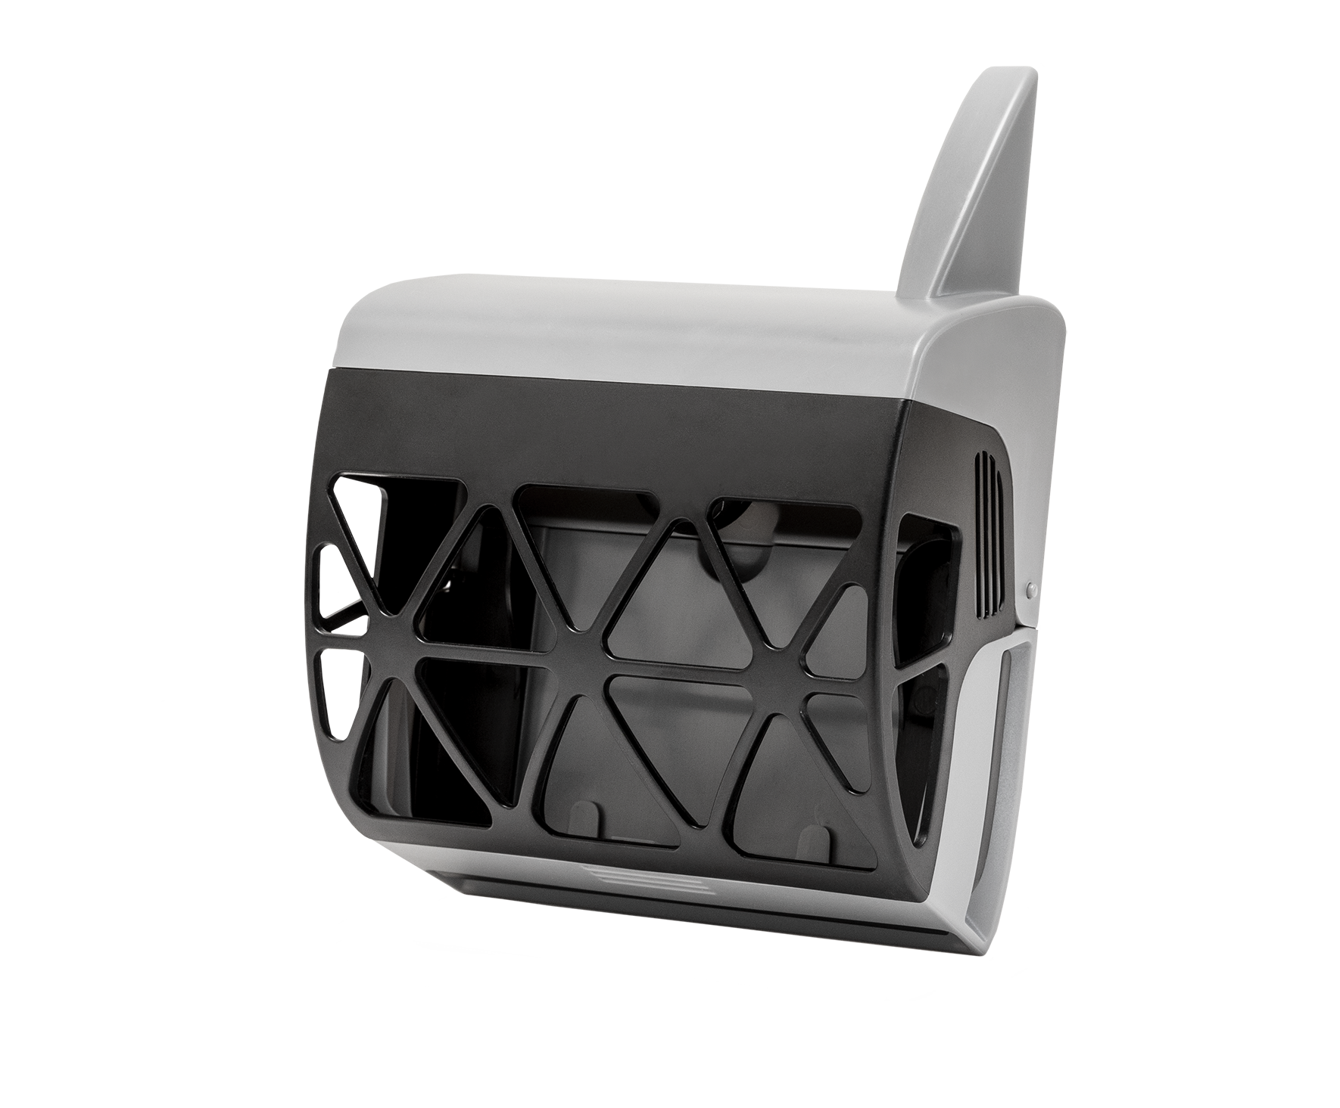
What is Smart Sense?
Smart Sense for cockroaches
First Smart product for insects
Two-in-one product for both moth and cockroaches
Early warning system for detection of moth and cockroaches
Fully compatible with the existing Rodent Smart system
24 / 7 monitoring
Data is monitored and tracked
Smart Sense for moth

Slide 10
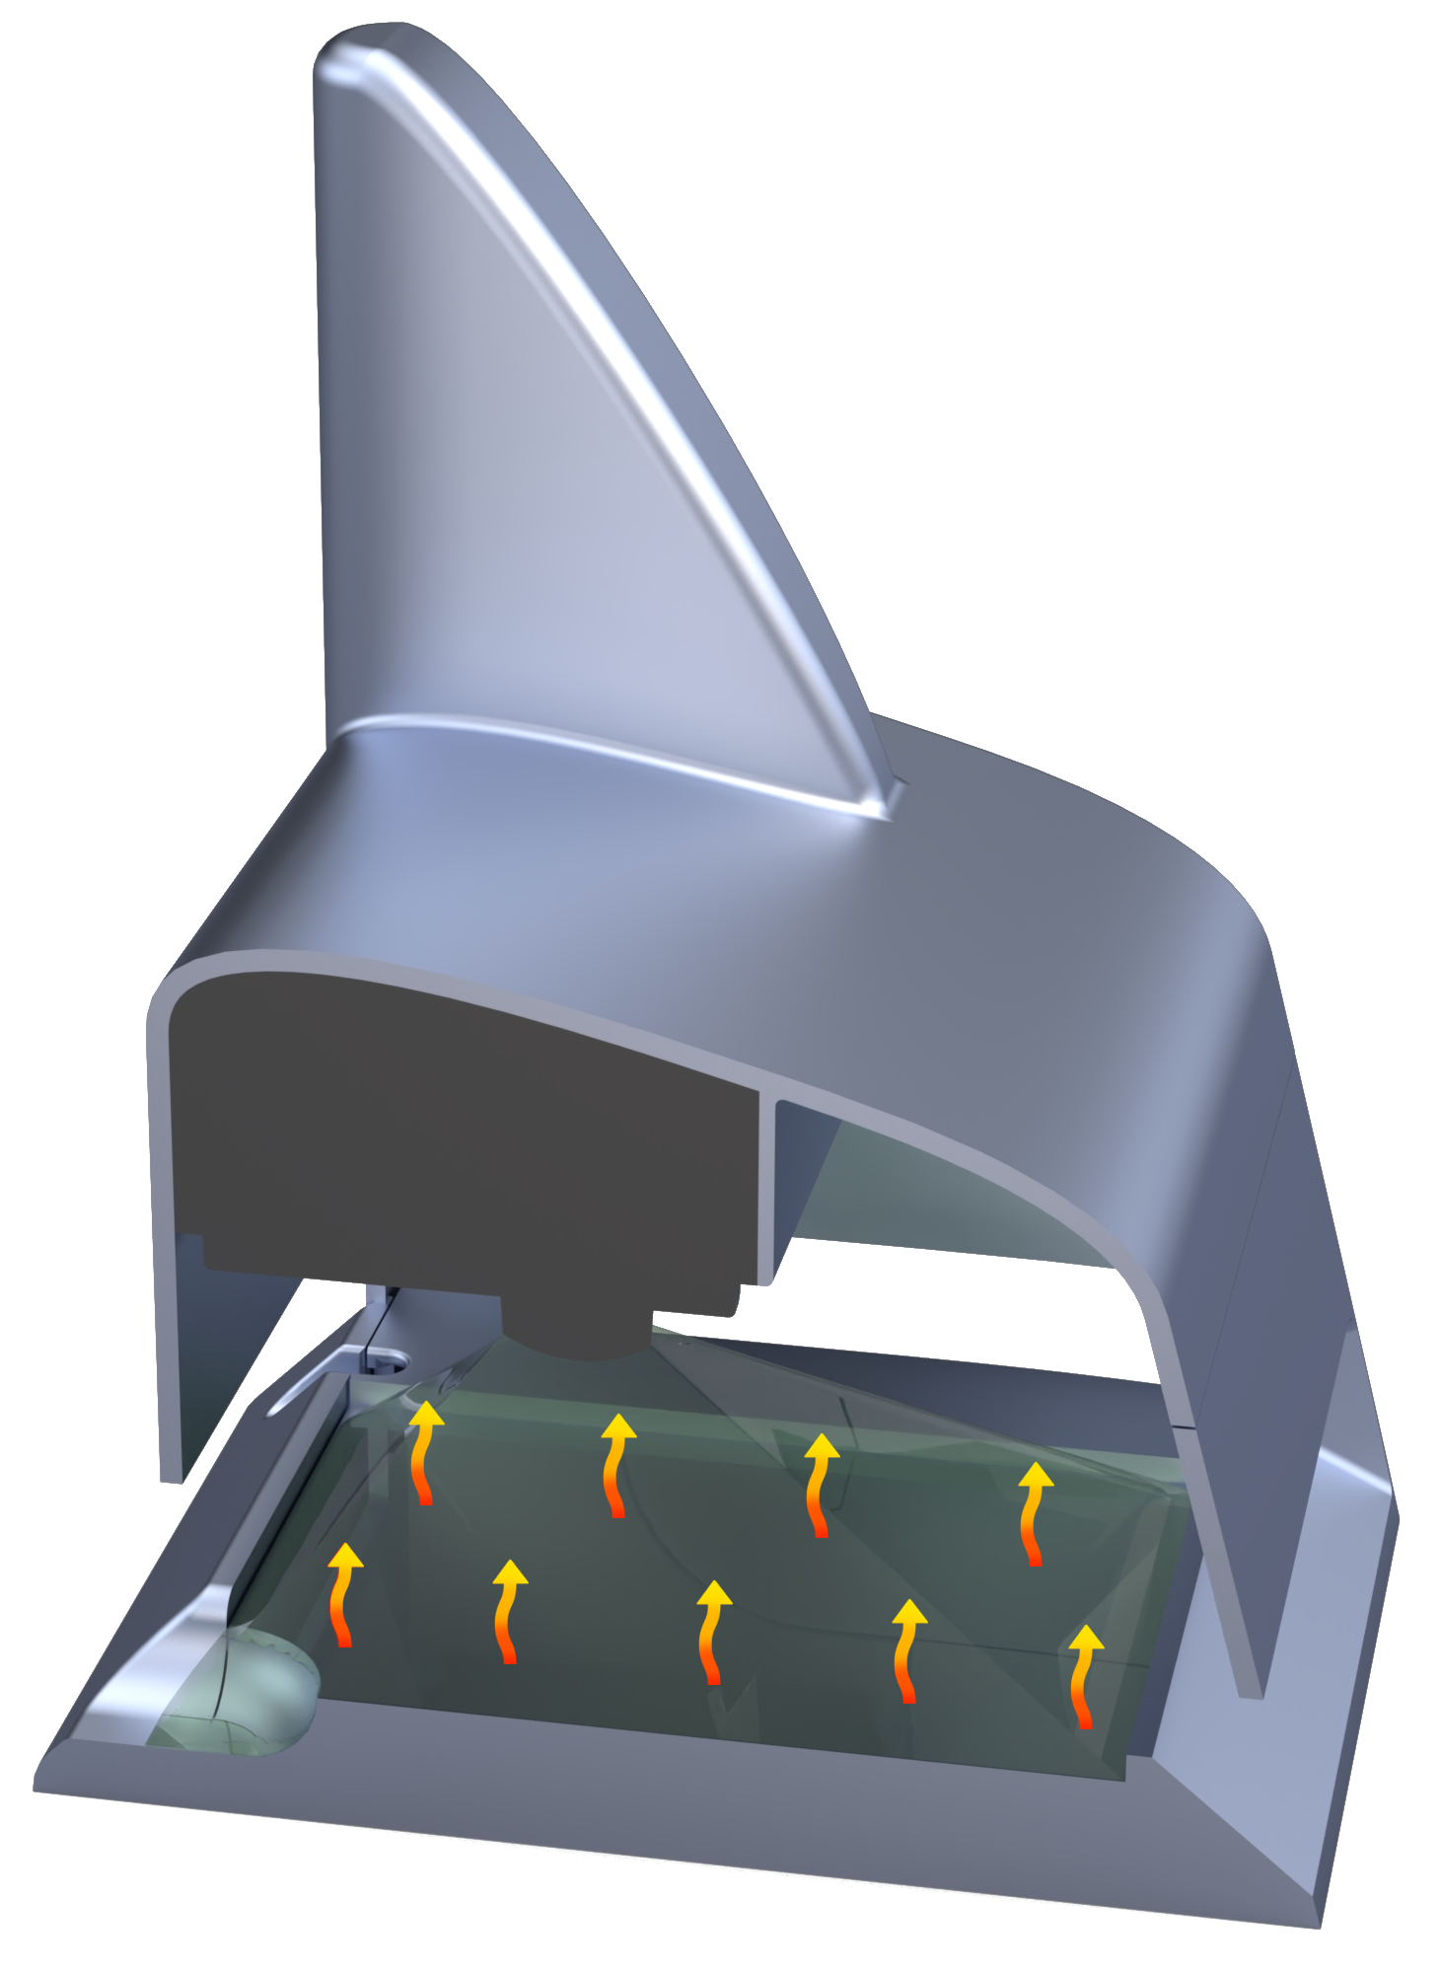
How does the product work?
Smart Sense has a build-in heat plate and PIR sensor.
Moth version = wall mounted
Cockroach version = floor mounted
Only for indoor use (IP44)
Needs 240V
Use standard glue boards and pheromone to attract insects
Smart Sense detects insects with PIR technology
Notes:
Registration of insect because the insect have a different temp. Than the heat plate

Slide 11
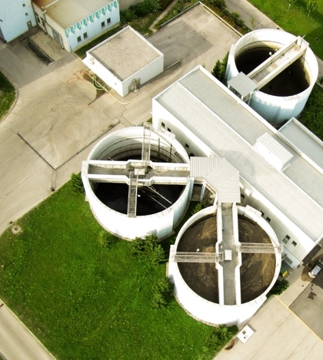
Businesses need to take proactive action, not reacting when it’s too late
To stay ahead of competition, our customers need to constantly think about how to improve every detail of their operations.
The global coverage of our customers increases constantly and risks become more critical, so does the need for proactive pest control.
Notes:
In today’s connected world, being on top of business risks, competition and improvements to every detail of your business – has never been more important. You need to have a plan for every part of your operations. Being proactive.
Not reacting when it’s too late.

Slide 12
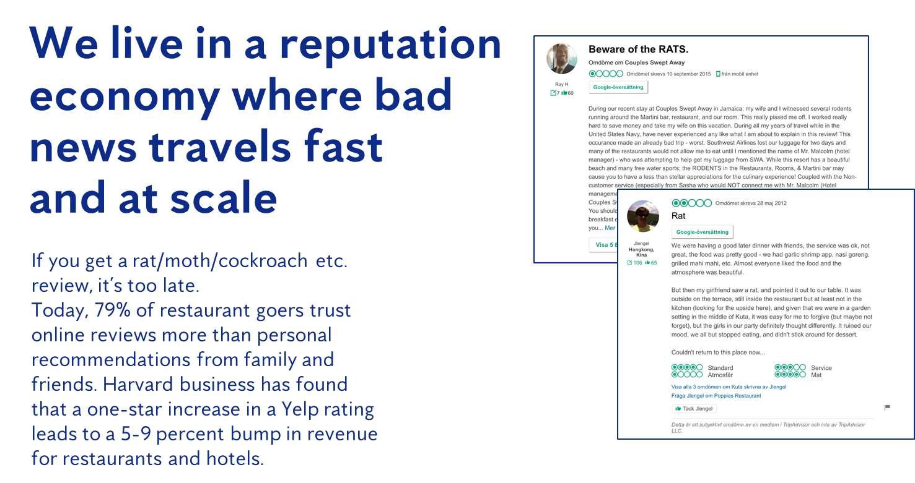
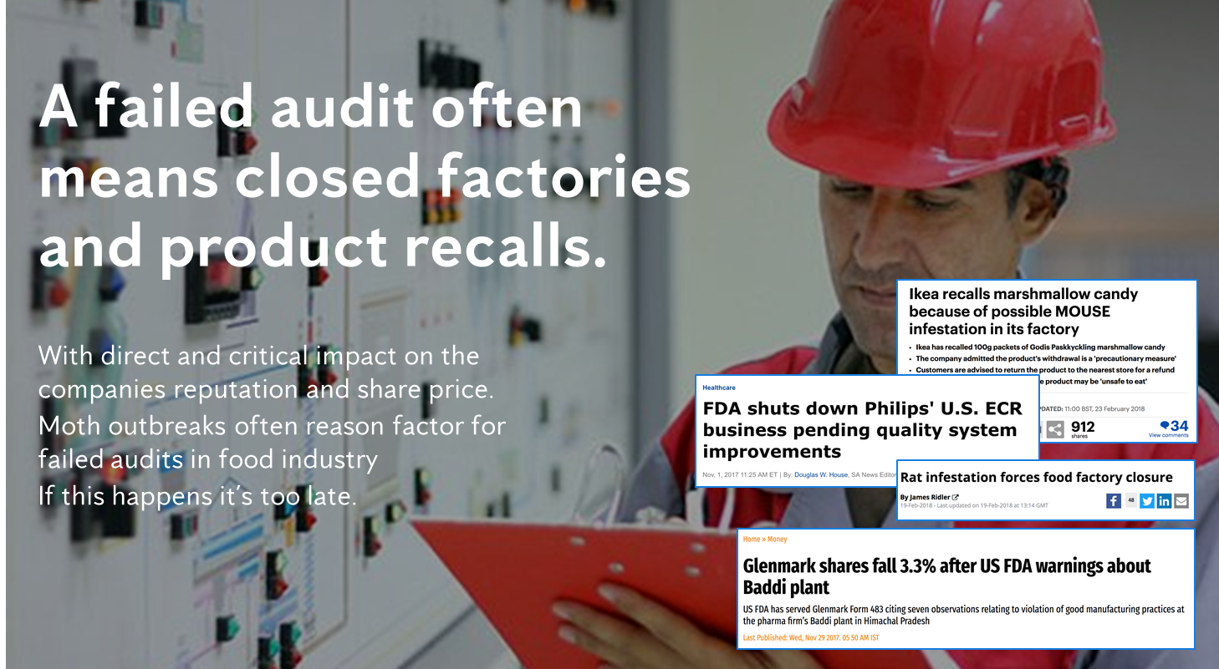
Commercial awareness is critical for survival

Slide 13

Thank you for your time.
Enjoy the

